Slide 1
General Chemistry (CHM 101) Modern Electronic Theory of Atoms
By
Dr. Edith Ofor

Slide 2
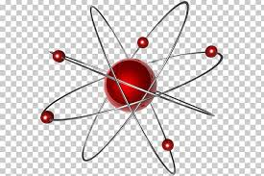
Modern Electronic Theory of Atoms
Learning Objectives
Students will be able to:
Explain the atomic theory and its evolution.
Discuss associated scientists and their roles in atomic theory.
Describe how each element gives off specific colors of light according to the absorbed and emitted energy.

Slide 3
OUTLINE
Introduction
History of the atom.
The basic atomic models
a. Dalton’s Billiard Ball model
i. Law of conservation of mass
ii. Isotopes
iii. Limitations of Dalton’s theory
b. Thomson’s Plum Pudding model
c. Rutherford’s Nuclear model
d. Bohr’s Planetary model
e. Schrodinger’s Cloud model

Slide 4
INTRODUCTION
"Everything you hear, see, smell, taste, and touch involves chemistry and chemicals (matter)," according to the American Chemical Society (ACS)
"And hearing, seeing, tasting, and touching all involve intricate series of chemical reactions and interactions."
According to the ACS, chemistry is the study of matter, and the changes that it undergoes when subjected to different environments and conditions.
Study of matter
Mass or Composition
Properties - color, malleability, odour
Transformation - melting, freezing
Chemical Properties – reactions with air, acid, base, etc.

Slide 5

INTRODUCTION

Slide 6
Why Chemistry to a computer scientist?
In the modern age of electronics, the silicon computer chip has revolutionized life.
Almost all modern products use chip technology.
Jack Kilby received a U.S. patent for miniaturized electronic circuits and Robert Noyce (received a patent for a silicon-based integrated circuit) were the inventors of microchips technology
The entire field of supercomputing needs computer scientists with a working familiarity with other fields of science including chemistry!
Silicon (Si) is an element with atomic number 14.
ideal semiconductor of electricity.
metalloid with a marked metallic luster.
very brittle, etc.

Slide 7
Why Chemistry to a computer scientist?
Liquid crystals and organic light emitting diodes (OLEDs) are very useful in computer /electronic display technology - computer monitors, handheld devices, TVs, etc.
Molecules like synthesized DNAs are becoming alternatives to hard drives - memory devices.

Slide 8
Why Chemistry to a computer scientist?
Computer scientists can develop numerous chemistry applications
Topics | Programs needed | Websites
1) Chemical structure drawing software. | ACD “chemsketch” program : Chemdraw | www.acdlabs.com
2) Exploration of structures in 3D | ACD 3D viewer, Rasmol, Pymol, | www.acdlabs.com
3) Chemical Databases and their utility | CCDC software quest, vista, etc..(xwindows to be used to connect to linux machines) | www.ccdc.cam.ac.uk
4) Electronic Structure methods | mopac (freeware) / Gaussian | www.gaussian.com
5) Chemical Literature search (Scifinder and web of science) | IISc licence available to all Scifinder (web based, Available for all users)
6) Electronic Lab Notebook keeping | Electronic lab notebook
7) Spectroscopy (Data collection, Data processing, and visualization) | Gnuplot , (freeware) NUTS (for NMR), etc.. | www.gnuplot.info http://www.acornnmr.com/
8) Kinetics and Thermodynamics | Kineticus (freeware) | Kintecus.com
Electrochemical software.

Slide 9
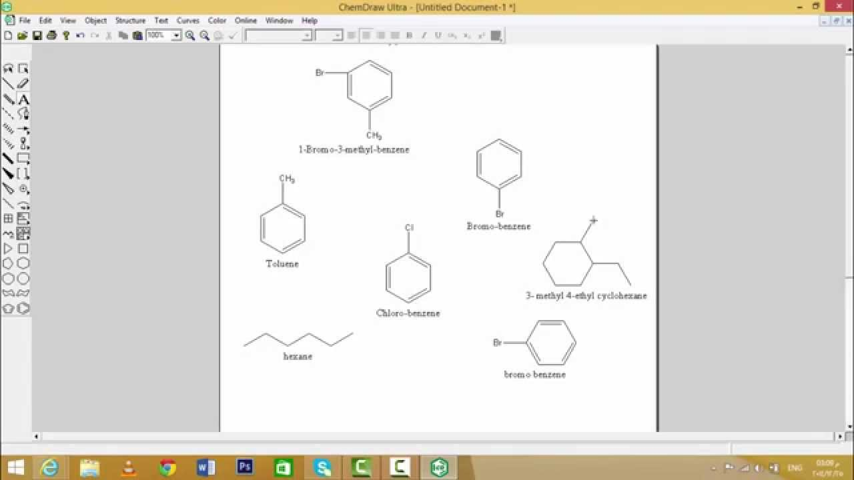
Why Chemistry to a computer scientist?
The Chemdraw Interface
Beyond the ability to create chemically accurate and legible figures, ChemDraw can perform in-depth analyses of compounds and predict their properties

Slide 10
Why Chemistry to an Engineer?
Chemical engineering
design or optimization of processes in the chemical industry (chemistry on daily basis).
Civil or environmental engineering
environmental protection
remediation
chemical reactions taking place in the water supply or the air.

Slide 11
Introduction Contd.
Modern mechanical, electrical /electronics engineering
Electricity can be thought of as a flow of electrons - the negatively charged particles in atoms.
relies on solid-state devices whose properties can be ‘tailored’ by carefully controlling their chemical compositions.

Slide 12
Introduction contd.
Prevention of danger
Lung cancer is associated with occupational exposures to crystalline silica, specifically quartz and cristobalite (report).
NOTE: We will be able to use the good qualities and avoid the dangers associated with materials ONLY if we know their compositions, properties and chemical reactions.

Slide 13
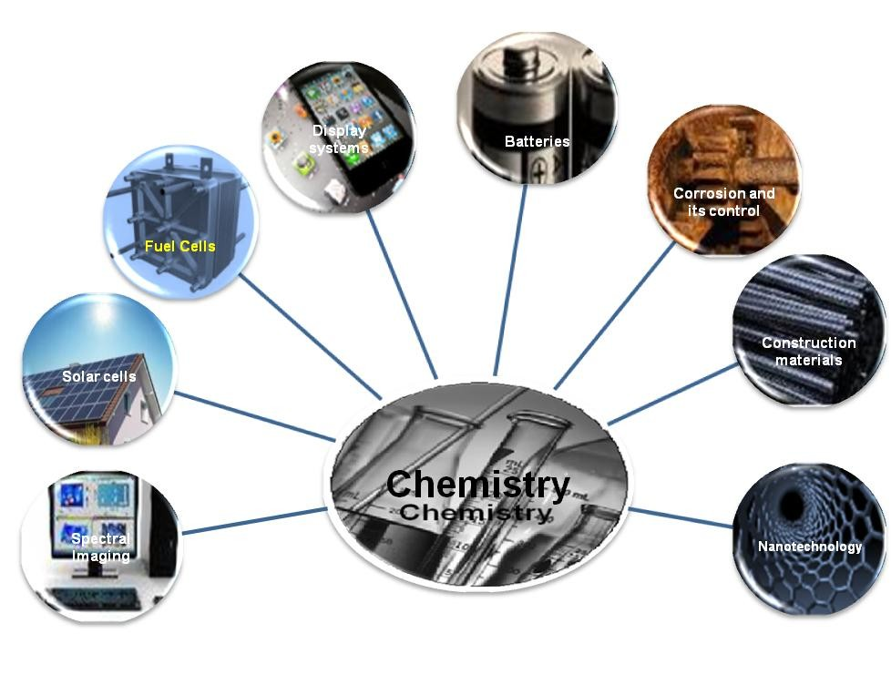
Introduction contd.
Chemistry in all

Slide 14
Modern Electronic Theory of Atoms
This is the description of electronic theories/models of atoms
and atomic structures
developed by
scientists.
It is helpful to always think about how science is evolving
learning new things
modifying existing theories
making new discoveries

Slide 15
The scientific method involves the following steps:
Forming a question
Performing background research
Creating a hypothesis
Designing an experiment
Collecting data
Analyzing the results
Drawing conclusions
Communicating the results

Slide 16
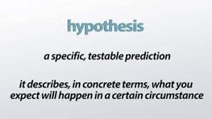
Hypotheses, Models, Laws and Theories
Though interchangeably used sometimes, scientists have very strict definitions of these terms.
Hypothesis
This is an observation, usually based on a cause and effect.
It is the basic idea that has not been tested; just an idea that explains something.
It must go through a number of experiments designed to prove or disprove it.
In the scientific method, a hypothesis represents what the researchers think will happen in an experiment.
Example
Eating greasy food causes pimples

Slide 17
Models/Laws
A hypothesis becomes a model after some testing has been done and it appears to be a valid observation.
Some models are only valid in specific instances, such as when a value falls within a certain range.
A model may also be called a law.

Slide 18
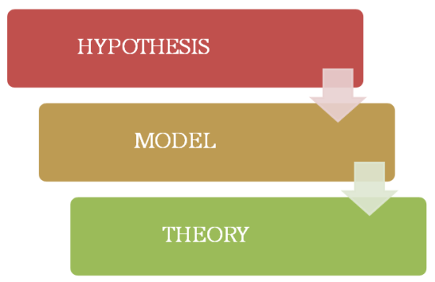
Scientific Theory
Repeatedly tested and confirmed models may become scientific theories -
if tested by a number of independent researchers around the world.
by using various experiments, and all have supported the theory.
Theories may be disproven, of course, but only after rigorous testing of a new hypothesis that seems to contradict them.

Slide 19
History of the Atom
Democritus (400BC)
Greek philosopher who proposes the existence of the atom.
He pounded materials until he made them into smaller and smaller parts and called them atoma which is Greek name for “indivisible”.
Believed that the universe is made of invisible units called atoms.

Slide 20
Democritus
All atoms are small hard particles
made of a single material.
formed into different shapes and sizes.
always moving.
that form different materials by joining together.
Democritus Guessed!
No Experiment!
Ridiculous Idea!
Aristotle said “He’s a quack!!!”
Took 2000 yrs to be proved right!

Slide 21
5 Basic Atomic Models
Atomic models which have contributed to the structure of the atom itself:
John Dalton's atomic model: Dalton´s Billiard Ball (Solid Sphere) Model
J.J. Thomson's model: Plum Pudding model
Ernest Rutherford's model: Nuclear model
Niels Bohr's model: Planetary model
Erwin Schrödinger's model: Electron Cloud/ Quantum Model

Slide 22
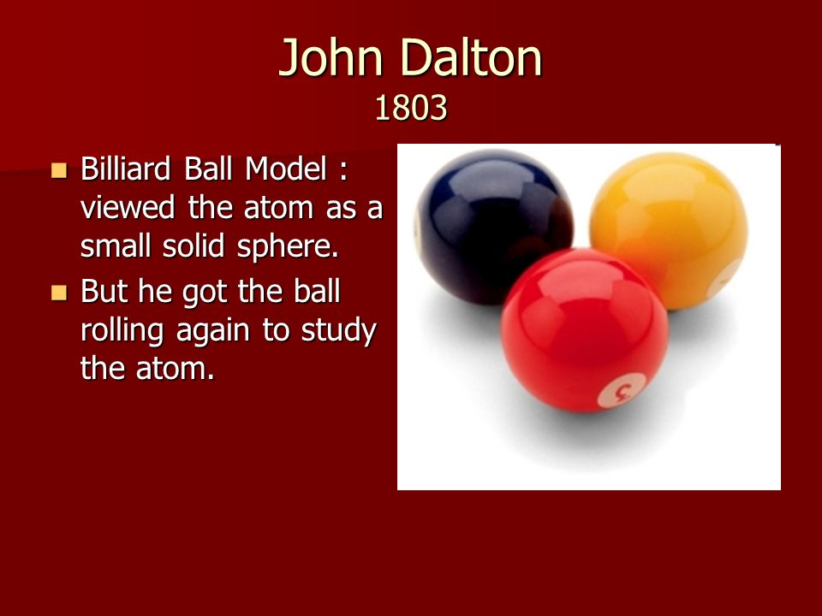
John Dalton’s Atomic Theory
Dalton thought that atoms were the smallest particles of matter. He envisioned them as solid, hard spheres, like billiard (pool) balls hence his model is known as Billiard Ball Model!
Based on his research results, he was able to demonstrate that atoms actually do exist, something that Democritus had only guessed.
Dalton's modern atomic theory, is a fundamental concept that states that all elements are composed of atoms.
Previously, atom was defined as the smallest part of an element that maintains the identity of that element.

Slide 23
Dalton’s atomic theory
Dalton's atomic theory was the first complete attempt to describe all matter in terms of atoms and their properties.
Dalton was the first scientist to explain the behavior of atoms in terms of the measurement of weight.

Slide 24
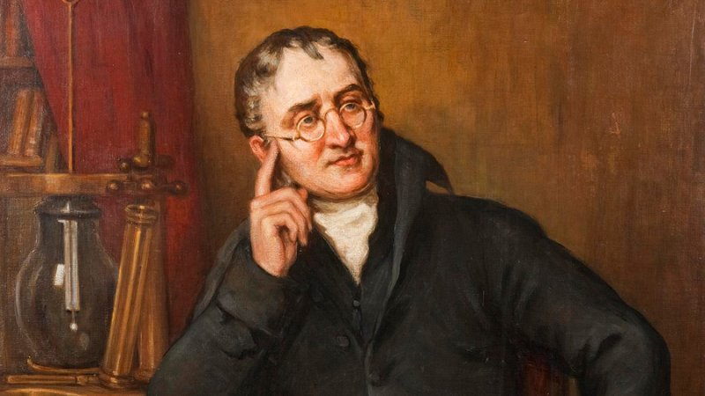
Summary of Dalton’s Atomic Theory
1. Matter is composed of extremely small indivisible particles called atoms.
2. Atoms of a given element are identical in size, mass and other properties.
3. Atoms can neither be created or destroyed.
4. Atoms of different elements combine in simple whole number ratios to form chemical compounds.
5. In chemical reactions, atoms are combined, separated or rearranged but not destroyed.

Slide 25
Question
Of the 5 points in the theory, which ones are still true/correct today?
All of them are still correct.
#1, #2, and #5
#4 and #5
#2 and #3

Slide 26
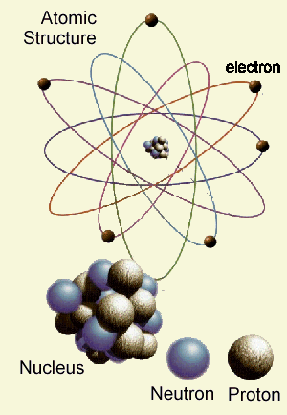
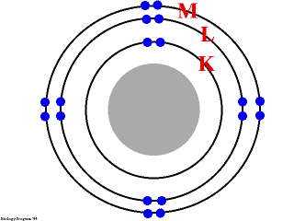
Limitations of Dalton’s Atomic Theory
Matter is composed of extremely small, indivisible particles called atoms.
This is no longer true with the discovery of subatomic particles: protons, neutrons and electrons.

Slide 27
Limitations contd.
All atoms of the same element are the same, is no longer true!
Elements have isotopes - the same element with a different number of neutrons.
Examples
Hydrogen ¹ H, ²H
Helium ³He, ⁴He
Lithium ⁶Li, ⁷Li

Slide 28
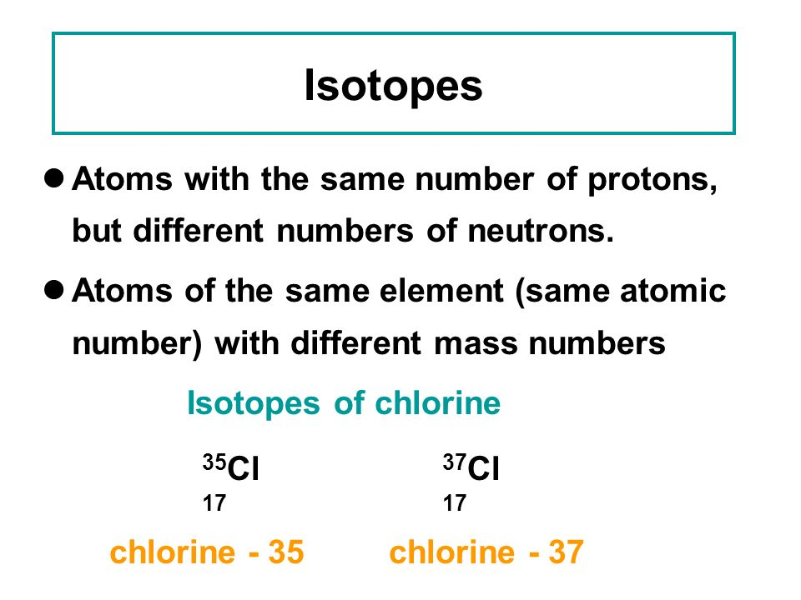
Limitations of Dalton’s Atomic Theory
All matter is composed of extremely small particles called atoms.
This is no longer true with the discovery of subatomic particles: protons, neutrons and electrons.

Slide 29
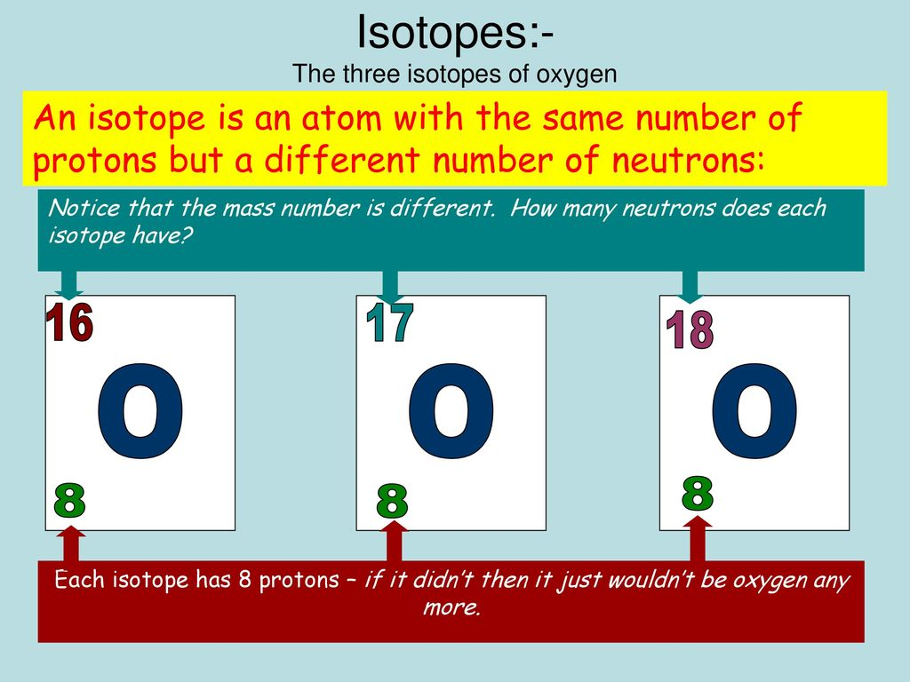
Limitations contd.
All atoms of the same element are the same, is no longer true!
Elements have isotopes - the same element with a different number of neutrons.
Examples
Hydrogen ¹ H, ²H
Helium ³He, ⁴He
Lithium ⁶Li, ⁷Li

Slide 30
Calculating relative atomic masses from isotopic composition
The naturally-occurring form of an element is usually a mixture of its various isotopes.
Each isotope has a different relative atomic mass (RAM or A_{r}).
The relative mass of the mixtures depends on the proportion of the various isotopes.
The relative atomic mass of an element takes into account the different masses and the abundance of the isotopes in the naturally occurring element (meaning the percentage of each isotope present).

Slide 31
Calculating the relative atomic mass
Bromine consists of two isotopes, 50% ⁷⁹Br and 50% ⁸¹Br, calculate the A_{r} of bromine from the mass numbers.
Think of the calculation in terms of '100 atoms‘
A_{r} = [(50 x 79) + (50 x 81)] /100 = 80
So the relative atomic mass of bromine is 80 or RAM or A_{r} (Br) = 80

Slide 32
Question
Silver atoms consist of 51.4% of the isotope ¹⁰⁷Ag and 48.6% of the isotope ¹⁰⁹Ag. Calculate the relative atomic mass of silver.

Slide 33
Solution
(51.4 x 107) + (48.6 x 109)
100
5499.8 + 5297.4
100
A_{r}(Ag) = 108.0
The relative atomic mass of silver is 108.0 (to 1 decimal place)

Slide 34
How do we know the isotopes and how much of each that is present?
The relative proportions of isotopes can be determined experimentally using a mass spectrometer
which uses both electric and magnetic fields to sort atoms by atomic mass.
The relative proportion of atoms with the various mass numbers are then recorded on a graph.
The height of the peak for each isotope depends on its relative abundance.

Slide 35
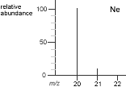
How do we know the isotopes and how much of each that is present?

Slide 36
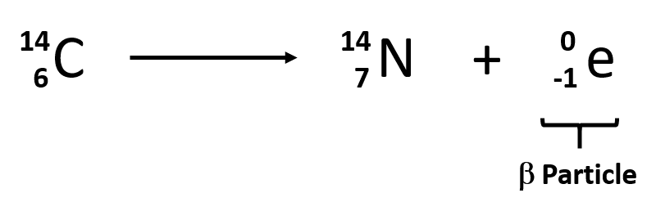
Limitations contd.
Atoms cannot be subdivided, created nor destroyed.
Nuclear chemistry has demonstrated that radioactive elements can decay and break down to form other elements and release energy in the process.

Slide 37

Still True!
Atoms of different elements combine in simple whole number ratios to form chemical compounds.
In chemical reactions, atoms are combined, separated or rearranged but not destroyed.

Slide 38
Dalton’s Atomic theory
Dalton supported his theory using research results.
Dalton based his theory on the law of conservation of mass and the law of constant composition (law of definite proportion).

Slide 39
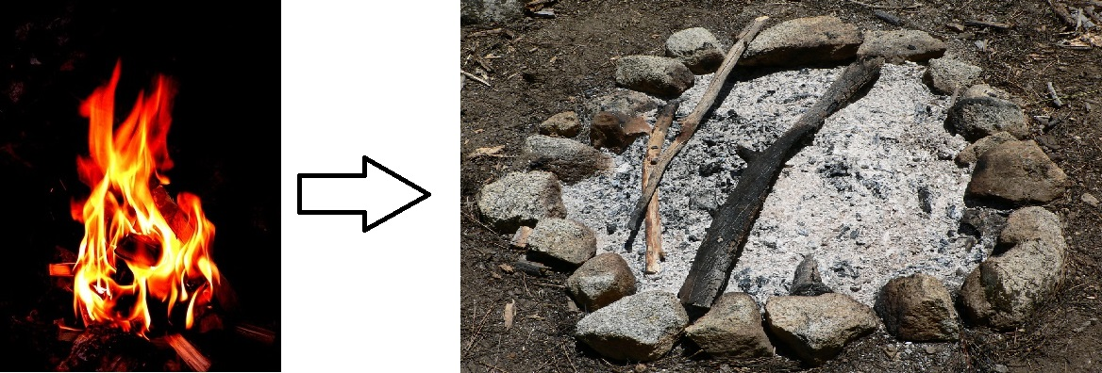
Law of Conservation of Mass
The total mass of matter after the fire would be the same as the total mass of matter before the fire.
Burning is a chemical process.
The flames are caused as a result of the fuel undergoing combustion (burning).

Slide 40
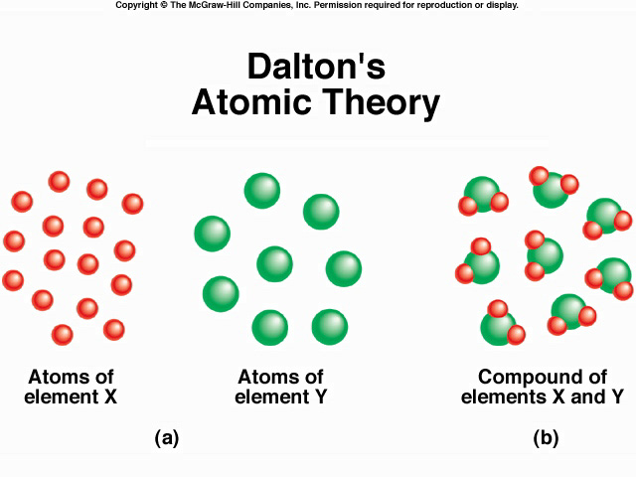
Law of Conservation of Mass
According to the law of conservation of mass, the mass of the products in a chemical reaction must equal the mass of the reactants.

Slide 41
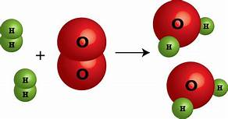
Law of conservation of mass
The number of each type of atom on each side of the reaction is the same (or is conserved). The atoms are just rearranged to make new substances.

Slide 42
Law of conservation of mass
Example:
If heating 10.0g of CaCO₃ produces 4.4 g of CO₂ and 5.6 g of CaO, show that these observations are in agreement with the law of conservation of mass.
Solution
Mass of the reactants = Mass of the products
10.0g of CaCO₃ = 5.6g of CaO + 4.4g of CO₂
10.0g of reactant = 10.0g of products
Because the mass of the reactant is equal to the mass of the products, the observations are in agreement with the law of conservation of mass.

Slide 43
Question
A student combines 154g of CCL₄ and an unknown quantity of Br₂ in a sealed container to produce 243 g of CBr₂Cl₂ and 71g of Cl₂. How much Br₂ was used in the reaction, assuming the reactants are completely used up?
Solution
154g + x = 243g + 71g
x = 160 g
x is the mass of bromine consumed in the reaction.

Slide 44
Question
If the law of conservation of mass holds true, how much sodium chloride will react with 24.0g of silver nitrate to produce 7g of sodium nitrate and 18.70g of silver chloride?
Ans: 1.70g

Slide 45
Question
A 15.5g thin strip of iron is immersed in a solution containing 21.0g of
copper (II) sulphate, and copper begins to form. After a while, the reactions come to a halt because all of the copper (II) sulphate has reacted. The weight of the iron strip is discovered to be 8.5 g. The mass of formed copper is discovered to be 8.60g. How much iron (II) sulphate was formed in the reaction?
Solution
Fe + CuSO₄ → FeSO₄ + Cu
Mass of iron = Initial mass – Final mass =15.5 – 8.5 = 7.0g
Mass of copper (II) sulfate = 21.0g
Mass of copper = 8.60 g.
Let the mass of iron sulphate be x grams.
According to the law of conservation of mass, Mass of reactants = Mass of products
Mass of iron + Mass of copper (II) sulphate = Mass of copper + Mass of iron (II) sulphate
7 g + 21 g = 8.6 g + x g
x = 19.40 g; Therefore, 19.40g iron (II) sulphate was formed.

Slide 46
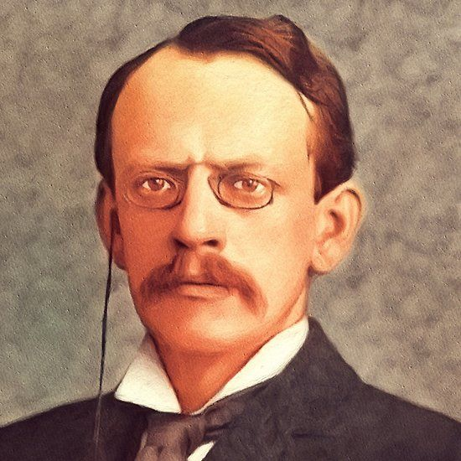
J. J. Thomson (1897)
Thomson regarded the atom as containing a large number of smaller bodies which he called corpuscles.
He then addressed the question, “how do the corpuscles arrange themselves in a sphere?”
He then carried out the cathode ray experiment.

Slide 47
Cathode Ray Tube
A cathode-ray tube (CRT) is a device that uses a beam of electrons in order to produce an image on a screen.
It is widely used in a number of electrical devices:
computer screens
television sets
radar screens
oscilloscopes used for scientific and medical purposes.

Slide 48
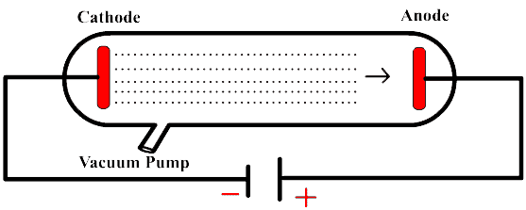
Normal Cathode Ray Tube (CRT)

Slide 49
Cathode Ray Tube
Cathode rays
form when high voltage is applied across electrodes in an evacuated tube.
The tube is evacuated to prevent electrons produced in the CRT from colliding with atoms and molecules within the tube.
move to the anode (positive electrode).
carry energy and can do work.
travel in straight lines in the absence of an external field.

Slide 50
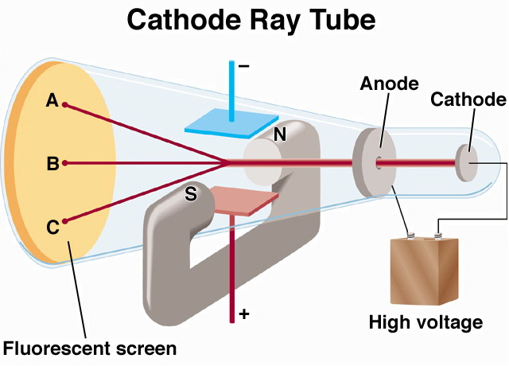
Thomson’s Plum- Pudding Model of Atom using Cathode ray tube

Slide 51
J. J. Thomson’s Theory
Between 1904 and about 1910, Thomson's model was generally accepted as the best available atomic theory.
What distinguishes Thomson's theory is his assignment of a specific inner structure to the atom.
The corpuscles are the electrons!

Slide 52
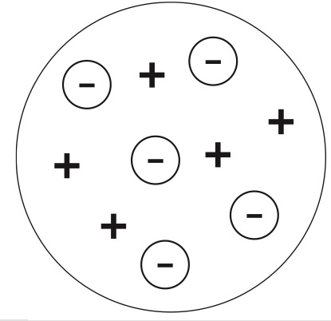
J. J.Thomson’s “Plum Pudding” or “Chocolate Chip Cookie” Model
J.J. Thomson came up with the idea of having charges embedded with Dalton’s Billiard Balls, using available data on the atom.
Also used cathode ray experiment to discover the existence of the electron.
positive
(evenly distributed)
“dough”
part
negative
“chocolate”
note: this model kept Dalton’s key ideas intact

Slide 53
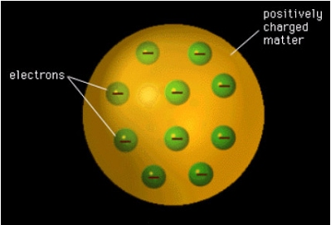
Plum-Pudding Model
Thompson developed the idea
that an atom was made up of electrons scattered unevenly within an elastic sphere surrounded by a soup of positive charge to balance the electron's charge

Slide 54
Watch and analyze the video:
https://www.youtube.com/watch?v=Rb6MguN0Uj4

Slide 55
Conclusion
Thomson compared the value of the mass/ charge ratio of an electron with that of the lightest charged particle.
weighed 1/1000 as much as hydrogen, the lightest atom.
He concluded that atoms do contain subatomic particles - atoms are divisible into smaller particles.
This conclusion contradicted Dalton’s postulate and was not widely accepted by fellow physicists and chemists of his day!
Thomson's model of the atom did explain some of the electrical properties of the atom due to the electrons, but failed to recognize the positive charges in the atom as particles.

Slide 56
Question
What was thought about the inside of an atom according to Thomson’s model?
It was mostly empty space.
It was a blob of negative material with positive charges embedded.
It was a blob of positive material with negative electrons embedded.

Slide 57
Question
What was the name of the currently accepted
model of the atom.
solid sphere
plum pudding
nuclear
electron cloud

